Slide 1
Introduction to Java for Business BU350.700.51 Spring I 2025
Programmer-Defined Classes

Slide 2
Programmer-Defined Java Classes
A class is a collection of data, methods and even objects from other classes that work together to get something done
By convention, class names in Java begin with an upper-case letter, but this is not enforced by the compiler
All the members of a class must be specified inside the class definition braces

Slide 3
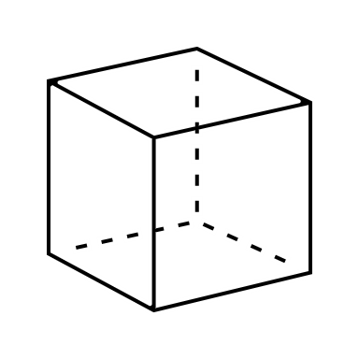
Defining a Simple Cube Class
// A class that models a cube
class Cube
{
int side; // value for the side of a cube
void setSide( int sideValue ) // Method to set value of side
{
side = sideValue;
}
int getVolume() // Method to get the volume
{
return side * side * side;
}
}
The scope of the data member side is the entire class
The member methods setSide() and getVolume() have access to side

Slide 4
Syntax For Creating Objects
ClassName ObjectName; // Declare the object name
ObjectName = new ClassName( [arguments] ); // Allocate storage
OR
ClassName ObjectName = new ClassName( [arguments] );
The ObjectName is a variable that is a reference to the object being created. For our simple Cube class, two instances (i.e., Cube objects) can be created as follows:
Cube cube1 = new Cube();
Cube cube2 = new Cube();

Slide 5
Creating & Manipulating Cube Objects
// Program to illustrate using Cube objects
public class CubeDemo1
{
public static void main( String [] args )
{
Cube cube1 = new Cube(); // Create a Cube object
Cube cube2 = new Cube(); // Create another Cube object
cube1.setSide( 10 ); // Set value for cube1's side
cube2.setSide( 20 ); // Set value for cube2's side
// Display volume of each cube object
System.out.println();
System.out.println( "cube1 volume is " + cube1.getVolume() );
System.out.println( "cube2 volume is " + cube2.getVolume() );
}
}

Slide 6
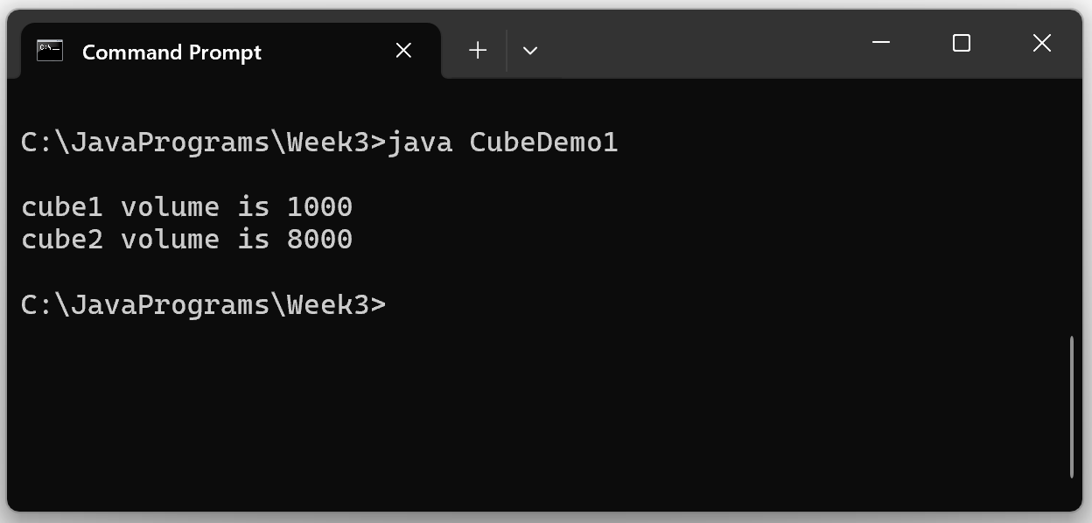
Sample Program Output

Slide 7
Informaton Hiding
A best-practice used in object-oriented design & programming is to hide certain members of a class from being accessed outside the class
This is called information hiding, and it is done to hide a class’s internal implementation & to maintain data integrity
Information hiding is accomplished using access modifiers
In general, we normally hide the data members and a subset of the method members

Slide 8
Access Modifiers
Access Modifier | Description
public | A public variable or method is visible anywhere where its class is visible.
private | A private variable or method is visible only to other class members.
protected | A protected variable or method is visible to other class and subclass members, and within its own package.
--- none --- | A variable or method is visible only within its own package.

Slide 9
Using Access Modifiers & Poor Information Hiding
Nothing is Hidden
// A class that models a cube
class Cube
{
public int side; // side is only accessible anywhere
public void setSide( int sideValue )
{
side = sideValue;
}
public int getVolume()
{
return side * side * side;
}
}

Slide 10
CubeDemo2 Program
All Class Members Are Public…Not a Good Practice
// Program to illustrate using Cube objects when all the Cube class
// members are public
public class CubeDemo2
{
public static void main( String [] args )
{
Cube aCube = new Cube(); // Create a Cube object
aCube.setSide( 10 ); // This is OK
aCube.side = -20; // This is legal but not smart
System.out.println();
System.out.println( "aCube side value is " + aCube.side );
System.out.println( "aCube volume is " + aCube.getVolume() );
}
}

Slide 11
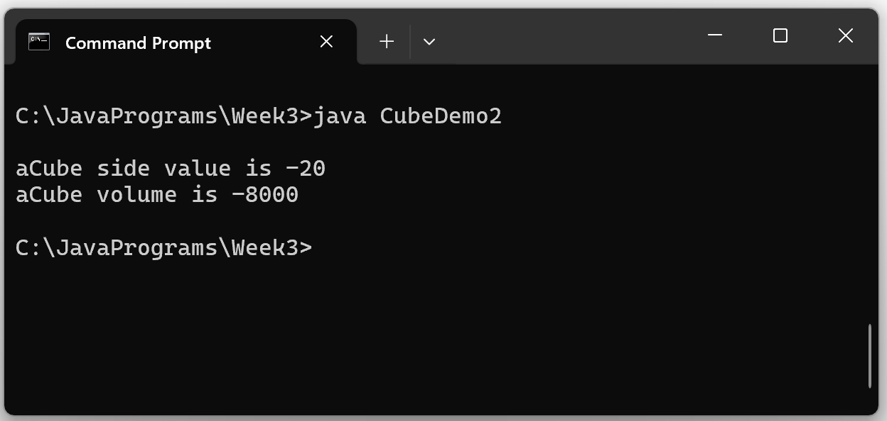
CubeDemo2 Output

Slide 12
Applying Access Modifiers & Basic Information Hiding
Data Member is Hidden From Direct Access
// A class that models a cube
class Cube
{
private int side; // side is only accessible by class members
public void setSide( int sideValue )
{
side = sideValue;
}
public int getVolume()
{
return side * side * side;
}
}

Slide 13
CubeDemo3 Program
Data Member is Hidden From Direct Access…But Still Could Be Corrupted
// Program to illustrate using Cube objects when Cube class data
// member is private, so it can’t be accessed directly. This is a
// good practice, but bad data value could still be possible by
// passing a negative value to setSide().
public class CubeDemo3
{
public static void main( String [] args )
{
Cube aCube = new Cube(); // Create a Cube object
aCube.setSide( 10 ); // This is OK
aCube.side = -20; // This is not legal
System.out.println();
System.out.println( "aCube side value is " + aCube.side );
System.out.println( "aCube volume is " + aCube.getVolume() );
}
}

Slide 14
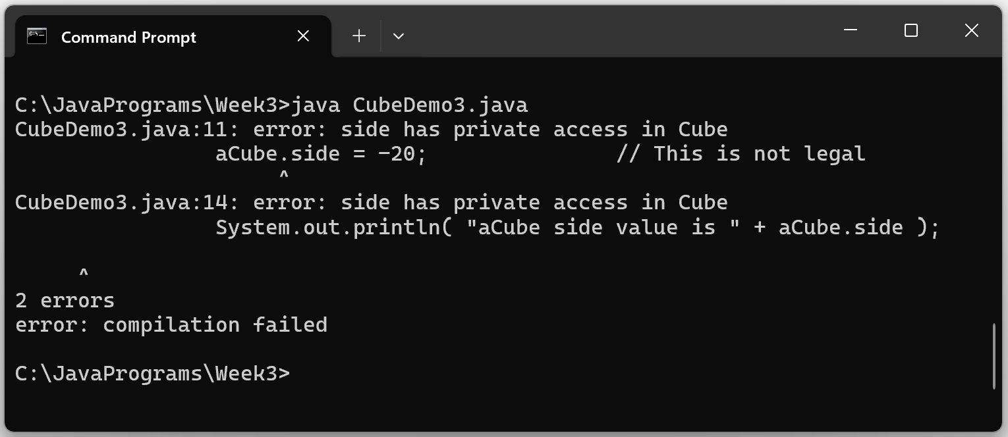
CubeDemo3 Code Won’t Compile

Slide 15
Using Access Modifiers and Good Information Hiding
Data Member is Hidden & setSide() value is edited
// A class that models a cube
class Cube
{
private int side; // side is only accessible by class members
public void setSide( int sideValue )
{
editSide( sideValue );
}
public int getVolume()
{
return side * side * side;
}
private void editSide( value )
{
if ( value > 0 )
side = value;
else
System.out.println( “ERROR: Side values must be > 0” );
}
}
??? Why do you think editSide() was made private???

Slide 16
CubeDemo4
// Program to illustrate using Cube objects when Cube class data
// member is private, so it can’t be accessed directly. The setSide()
// method has been modified so that only values > 0 are accepted.
public class CubeDemo4
{
public static void main( String [] args )
{
Cube aCube = new Cube(); // Create a Cube object
aCube.setSide( -10 ); // This will be edited
System.out.println();
System.out.println( "aCube volume is " + aCube.getVolume() );
}
}

Slide 17
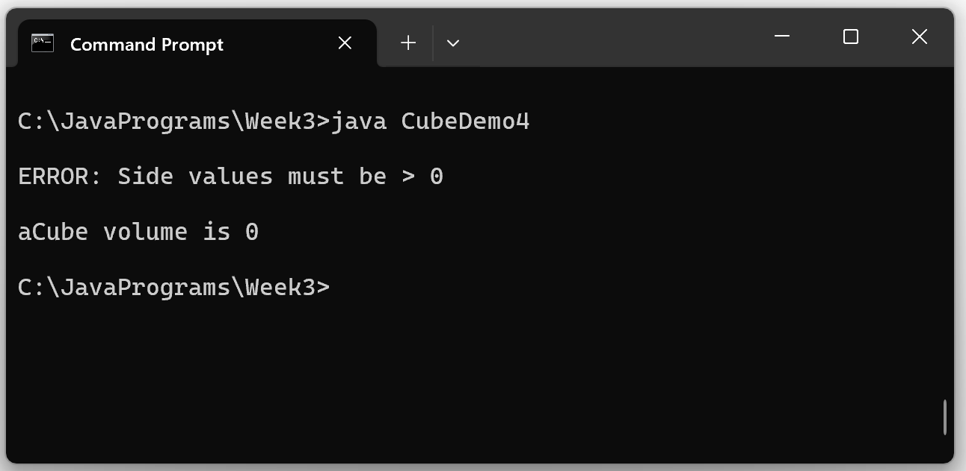
CubeDemo4 Sample Output
Data Integrity is Protected

Slide 18
Class Constructors
Class constructors are special methods that are used to initialize objects when they are created
Constructors are included in the class definition code and must obey the following rules:
Constructors must have exactly the same name as the class
Constructors must not have a return type
Constructors will generally use the public access modifier
Constructors are not mandatory, but it is a good idea to use them
When an object is instantiated its class constructor will automatically be executed
If a class has no defined constructor, then Java will automatically provide one. Java will initialize numeric members to zero, reference type members and members of type char to null, and members of type boolean to false

Slide 19
Default Constructor
A constructor method that does not take any arguments is called a default constructor
If a class is designed without any constructor methods, Java automatically provides a default constructor
Java does not provide a default constructor if a class has any constructors whatsoever

Slide 20
Default Constructor Demo
public class MyClass
{
private int x;
private int y;
public MyClass() // Default class constructor
{
x = 99;
y = 99;
}
public int getX() { return x; }
public int getY() { return y; }
}
// A program to illustrate a default constructor
public class DefaultConstructorDemo1
{
public static void main( String [] args )
{
MyClass aClass = new MyClass();
System.out.println();
System.out.println( "x is " + aClass.getX() );
System.out.println( "y is " + aClass.getY() );
}
}

Slide 21
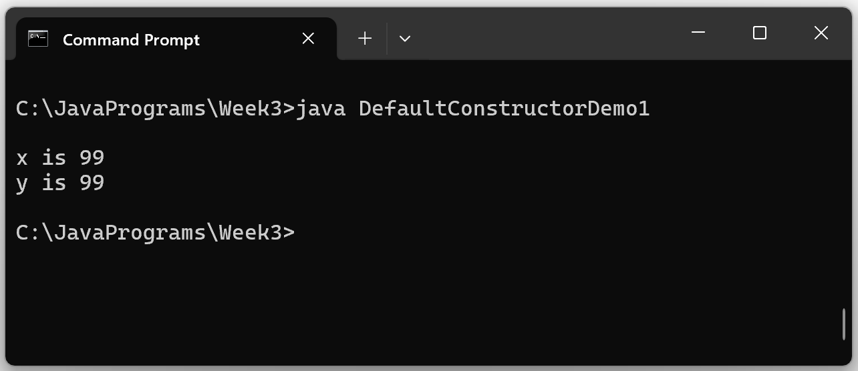
Default Constructor Demo1 Output

Slide 22
Java Provides a Default Constructor if No Constructors Are Defined
public class MyClass
{
private int x;
private int y;
public int getX() { return x; }
public int getY() { return y; }
}
// A program to illustrate a default constructor
public class DefaultConstructorDemo1
{
public static void main( String [] args )
{
MyClass aClass = new MyClass();
System.out.println();
System.out.println( "x is " + aClass.getX() );
System.out.println( "y is " + aClass.getY() );
}
}

Slide 23
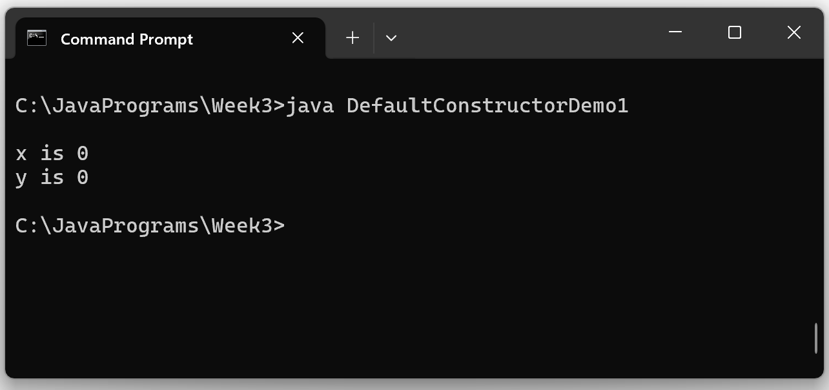
Default Constructor Demo Output

Slide 24
In-Class Initializers
public class MyClass
{
private int x = 0; // in-class initializer
private int y = 0; // in-class initializer
public int getX() { return x; }
public int getY() { return y; }
}
public class DefaultConstructorDemo1
{
public static void main( String [] args )
{
MyClass aClass = new MyClass();
System.out.println();
System.out.println( "x is " + aClass.getX() );
System.out.println( "y is " + aClass.getY() );
}
}

Slide 25
Parameterized Constructors
public class MyClass
{
private int x;
private int y;
public MyClass( int v1, int v2 )
{
x = v1; y = v2;
}
public int getX() { return x; }
public int getY() { return y; }
}
// A program to illustrate a parameterized constructor
public class ParameterizedConstructorDemo1
{
public static void main( String [] args )
{
MyClass aClass = new MyClass( 10, 20 );
System.out.println();
System.out.println( "x is " + aClass.getX() );
System.out.println( "y is " + aClass.getY() );
}
}

Slide 26
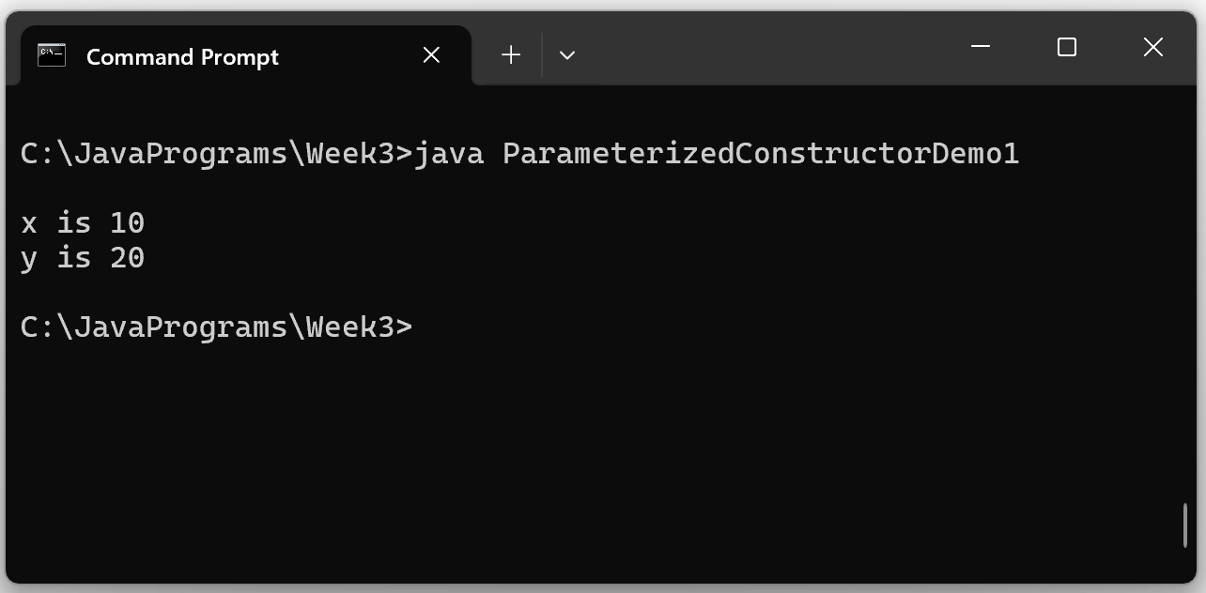
Parameterized Constructor Sample Output

Slide 27
This Program Won’t Compile
Since MyClass has a defined constructor Java won’t supply a default constructor
public class MyClass
{
private int x;
private int y;
public MyClass( int v1, int v2 )
{
x = v1; y = v2;
}
public int getX() { return x; }
public int getY() { return y; }
}
// A program to illustrate a parameterized constructor
public class ParameterizedConstructorDemo1
{
public static void main( String [] args )
{
MyClass aClass = new MyClass( 10, 20 );
MyClass anotherClass = new MyClass(); // WRONG!!
System.out.println();
System.out.println( "x is " + aClass.getX() );
System.out.println( "y is " + aClass.getY() );
}
}

Slide 28
Multiple Class Constructors
A class can have multiple constructors as long as the signatures of each constructor are different
Constructors having different signatures must have a different number of arguments, different argument types, or argument types in different positional parameters

Slide 29
Multiple Class Constructors
public class MyClass
{
private int x;
private int y;
public MyClass( int v1, int v2 )
{
x = v1; y = v2;
}
public MyClass() { x = 0; y = 0; }
public int getX() { return x; }
public int getY() { return y; }
}
// A program to illustrate a parameterized constructor
public class MultipleConstructorDemo
{
public static void main( String [] args )
{
MyClass aClass = new MyClass( 10, 20 );
MyClass anotherClass = new MyClass();
System.out.println();
System.out.println( "x is " + aClass.getX() );
System.out.println( "y is " + aClass.getY() );
}
}

